Slide 1
Indoor Positioning System
Wade Jarvis
Arthur Mason
Kevin Thornhill
Bobby Zhang
Mentor: Dr. Kemin Zhou

Slide 2
IPS Requirements
Design a safe, user friendly system that will be able to accurately locate and track multiple objects within a given area.
Ideally provide real time location and direction between the readers and the tags.
Last at least 1 year from battery power.
Overall, the system should operate at an estimated cost of $2000 for an area of 10,000 square feet.

Slide 3
XBee API Programming

Slide 4
XBee Transparent Programming
Serial.print(“Hello World”);
Broadcast to all nearby nodes
incomingByte = Serial.read();
Reads 1 byte of data from Serial buffer
XBee sends any incoming bytes through UART to Arduino

Slide 5
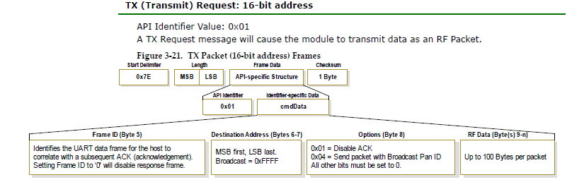
XBee API Programming

Slide 6
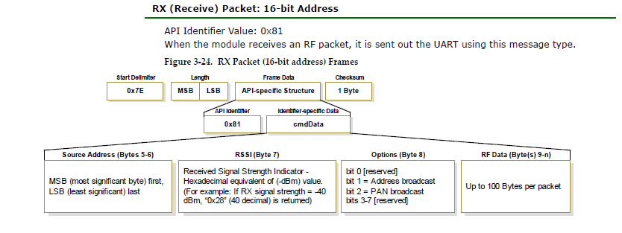
XBee API Programming

Slide 7
RSSI Signal/Distance

Slide 8
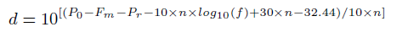
RSSI/Distance
Formula for Distance:
Fm = Fade Margin
N = Path-Loss Exponent, ranges from 2.7 to 4.3
Po = Signal power (dBm) at zero distance
Pr = Signal power (dBm) at distance
F = signal frequency in MHz

Slide 9
Trilateration

Slide 10
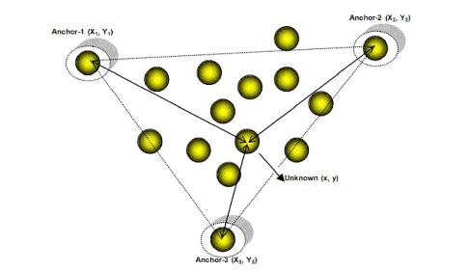
Trilateration
Trilateration is used to estimate the location of the unknown node
2D Trilateration
3D Trilateration

Slide 11
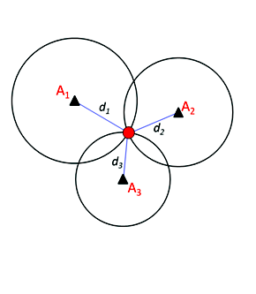
2D Trilateration
Distances (d1,d2,d3) are measured by an RSSI signal.
Therefore, there is a small unknown error for every distance calculated

Slide 12
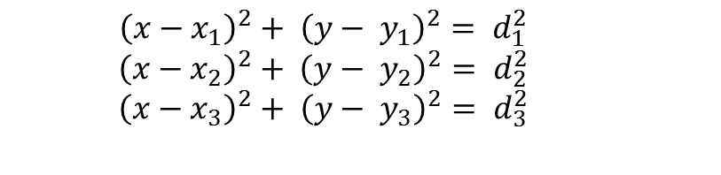
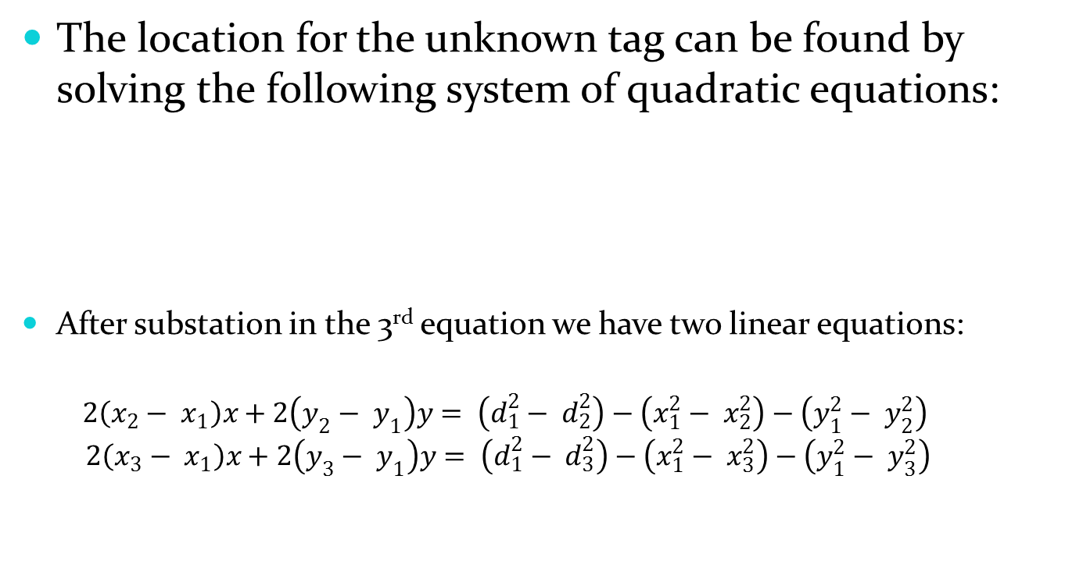
2D trilateration
The location for the unknown tag can be found by solving the following system of quadratic equations:
After substation in the 3rd equation we have two linear equations:
$$2\left(x_{2}− x_{1}\right)x+2\left(y_{2}− y_{1}\right)y= \left(d_{1}^{2}− d_{2}^{2}\right)−\left(x_{1}^{2}− x_{2}^{2}\right)−\left(y_{1}^{2}− y_{2}^{2}\right)$$
$$2\left(x_{3}− x_{1}\right)x+2\left(y_{3}− y_{1}\right)y= \left(d_{1}^{2}− d_{3}^{2}\right)−\left(x_{1}^{2}− x_{3}^{2}\right)−\left(y_{1}^{2}− y_{3}^{2}\right)$$
$${\left(x−x_{1}\right)}^{2}+ {\left(y− y_{1}\right)}^{2}= d_{1}^{2}$$
${\left(x−x_{2}\right)}^{2}+ {\left(y− y_{2}\right)}^{2}= d_{2}^{2}$
$${\left(x−x_{3}\right)}^{2}+ {\left(y− y_{3}\right)}^{2}= d_{3}^{2}$$

Slide 13
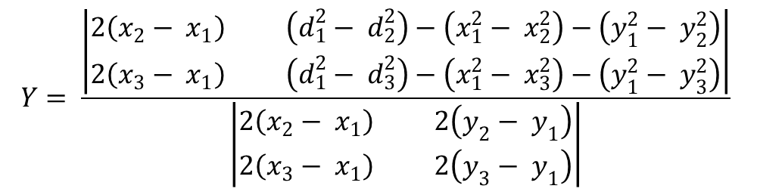
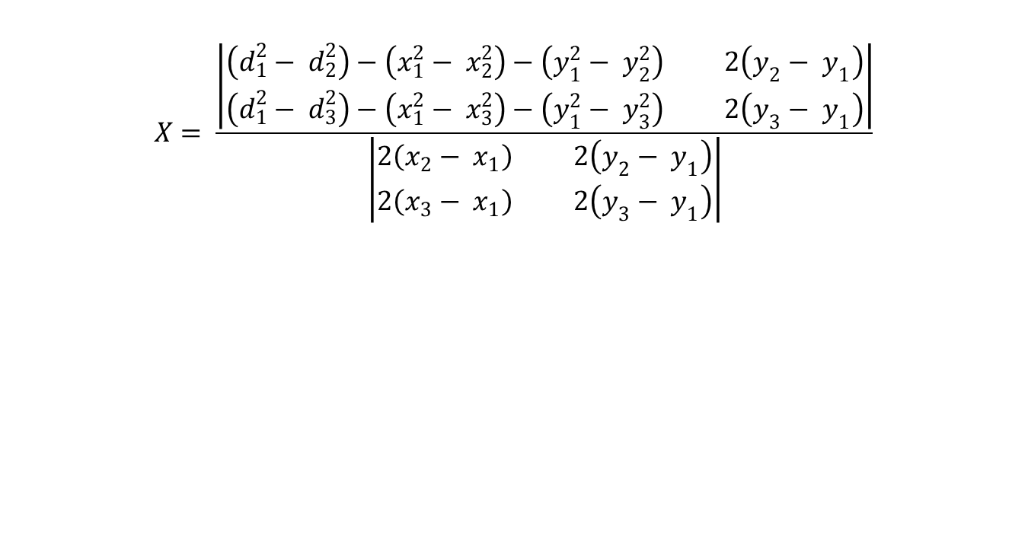
2D Trilateration
$$X= \frac{\left|\begin{matrix}\left(d_{1}^{2}− d_{2}^{2}\right)−\left(x_{1}^{2}− x_{2}^{2}\right)−\left(y_{1}^{2}− y_{2}^{2}\right) & 2\left(y_{2}− y_{1}\right) \\ \left(d_{1}^{2}− d_{3}^{2}\right)−\left(x_{1}^{2}− x_{3}^{2}\right)−\left(y_{1}^{2}− y_{3}^{2}\right) & 2\left(y_{3}− y_{1}\right)\end{matrix}\right|}{\left|\begin{matrix}2\left(x_{2}− x_{1}\right) & 2\left(y_{2}− y_{1}\right) \\ 2\left(x_{3}− x_{1}\right) & 2\left(y_{3}− y_{1}\right)\end{matrix}\right|}$$
$$Y= \frac{\left|\begin{matrix}2\left(x_{2}− x_{1}\right) & \left(d_{1}^{2}− d_{2}^{2}\right)−\left(x_{1}^{2}− x_{2}^{2}\right)−\left(y_{1}^{2}− y_{2}^{2}\right) \\ 2\left(x_{3}− x_{1}\right) & \left(d_{1}^{2}− d_{3}^{2}\right)−\left(x_{1}^{2}− x_{3}^{2}\right)−\left(y_{1}^{2}− y_{3}^{2}\right)\end{matrix}\right|}{\left|\begin{matrix}2\left(x_{2}− x_{1}\right) & 2\left(y_{2}− y_{1}\right) \\ 2\left(x_{3}− x_{1}\right) & 2\left(y_{3}− y_{1}\right)\end{matrix}\right|}$$

Slide 14
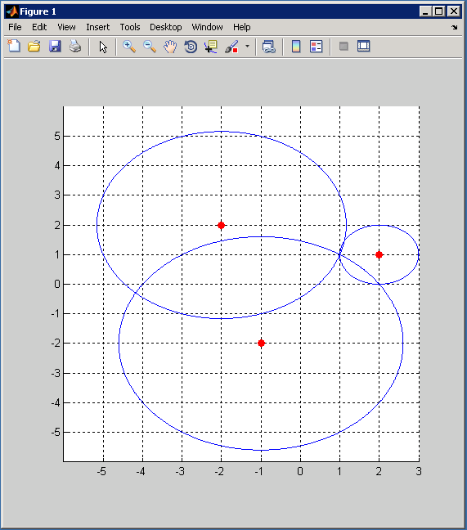
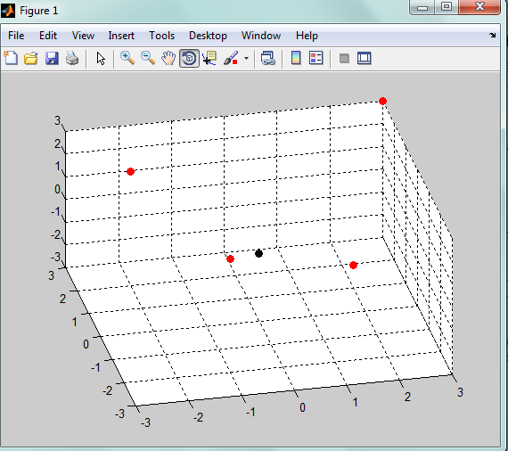
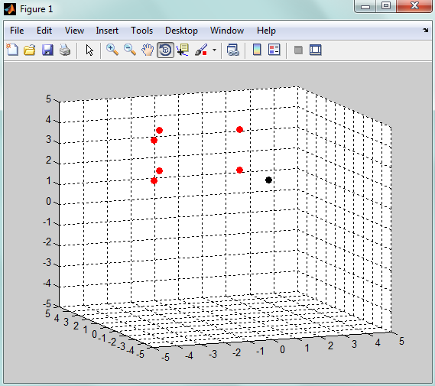
MATLAB Simulation

Slide 15
Detection Device

Slide 16
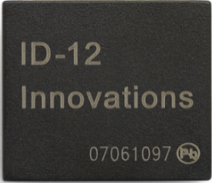
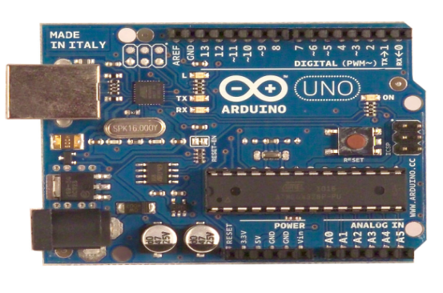
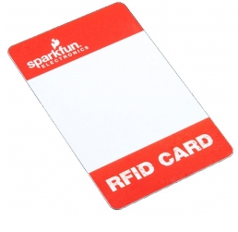
Detection Device
Innovation ID-12 chip
Arduino Uno
RFID Cards

Slide 17
Detection Device
Each RF card has a 12 digit unique ID
Linked to an object in the field
Sending the ID to Matlab:
Arduino Code
Matlab Code
Both codes have to be interfaced with each other

Slide 18
Database
Each unique ID is stored in the MATLAB database
Incoming ID will be compared to the IDs stored in MATLAB
After comparison, location of the object will be displayed on a graphical user interface

Slide 19
Power Requirements

Slide 20
Power Requirements
Portable
Long Battery Life
User-Friendly
Safe
Rechargeable

Slide 21
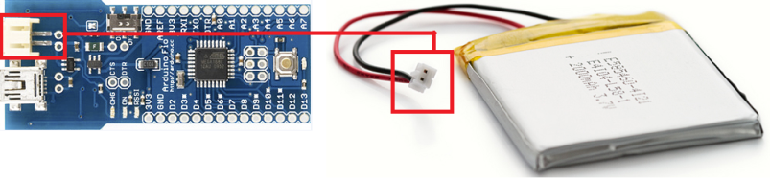
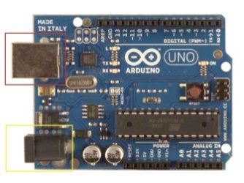
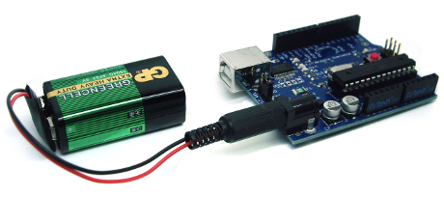
Powering Devices
RF tags lithium-ion polymer batteries
RF readers USB or DC power source

Slide 22
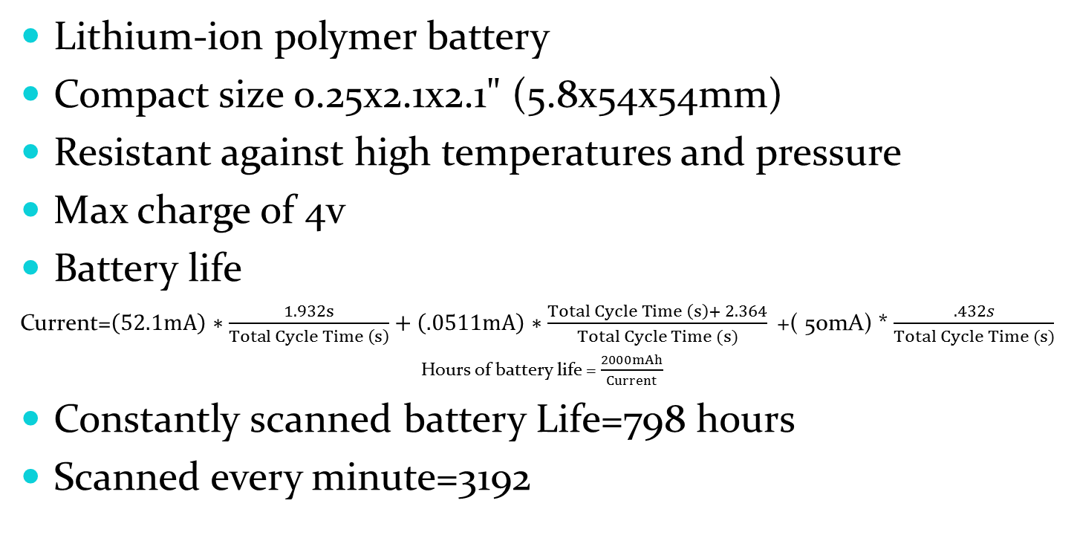
Battery & Battery Life
Lithium-ion polymer battery
Compact size 0.25x2.1x2.1" (5.8x54x54mm)
Resistant against high temperatures and pressure
Max charge of 4v
Battery life
Current=$\left(52.1mA\right)∗\frac{1.932s}{Total Cycle Time \left(s\right)}+\left(.0511mA\right)∗\frac{Total Cycle Time \left(s\right)+ 2.364}{Total Cycle Time (s)}$+( 50mA) * $\frac{.432s}{Total Cycle Time (s)}$
Hours of battery life = $\frac{2000mAh}{Current}$
Constantly scanned battery Life=798 hours
Scanned every minute=3192

Slide 23
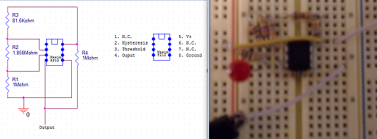
Power Indicator Circuit
Integrate into our RF tags
Cut-off voltage of 3.2v
Hysteresis of .05-.07v
Drop from high to low will cause a signal to be sent from the tag to the host computer to alert the user to charge the battery.

Slide 24
Battery Indicator Demonstration
Video Here

Slide 25
Distance Testing

Slide 26
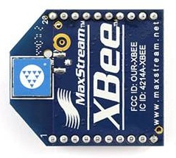
Distance Testing: Old Antennas
Tested the system using 1 reader and 1 tag
Received mixed results based on the orientation of the devices
Works accurately when facing away from each other
Results varied when devices were facing towards each other
 | Actual Distance | Calculated Distance
Away | 8 m | 8 m
Other Orientations | 8 m | 10-13 m

Slide 27
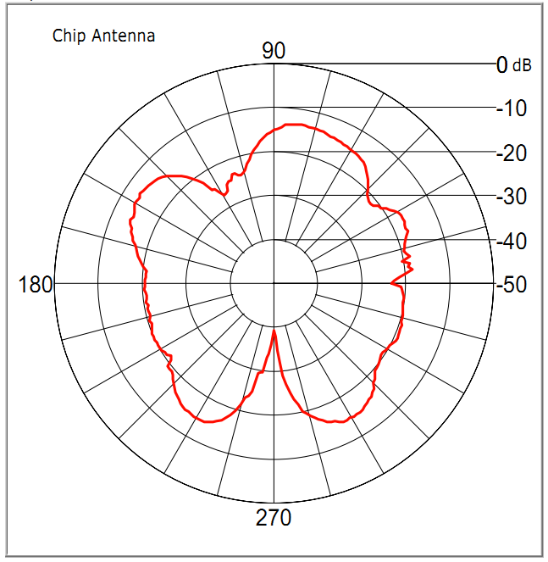
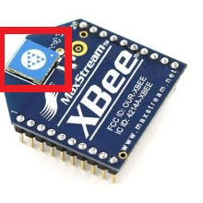
XBee Antenna
On board antenna
Non-uniform radiation pattern

Slide 28
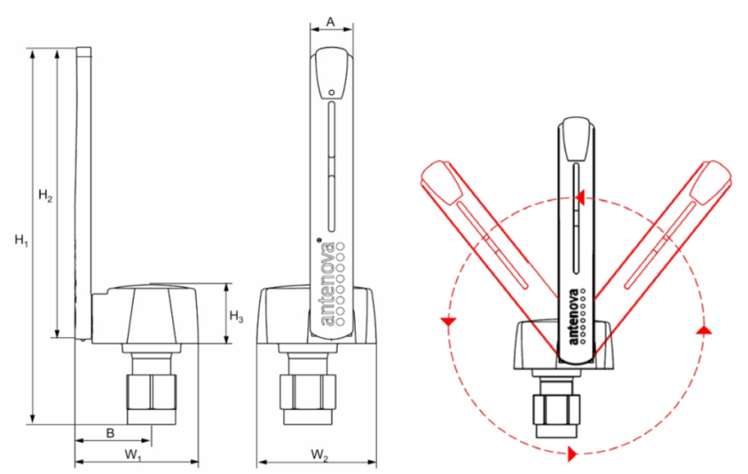
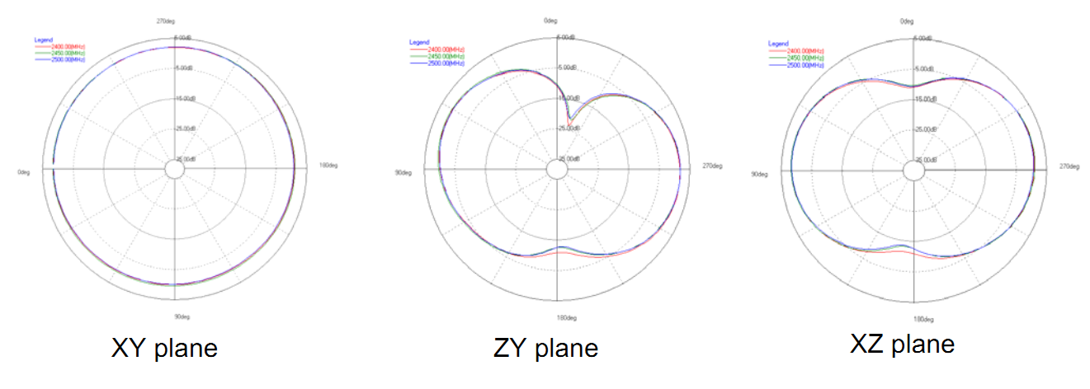
Antenova Titanis Antenna
Provided by Cameron group
Much better radiation pattern
Dead zone above
Sometimes too sensitive

Slide 29
Distance Testing: New Antennas
Tested the system using 3 readers and 1 tag
Received mixed results due to the environment
Ground testing: Inconsistent – varied results
Held up testing: Consistent – accurate results
Actual Distance | Calculated Distance
10 m | 10.5 m
6 m | 6 m
19.1 m | 19 m
21 m | 25 m

Slide 30
2-D Trilateration Tests

Slide 31
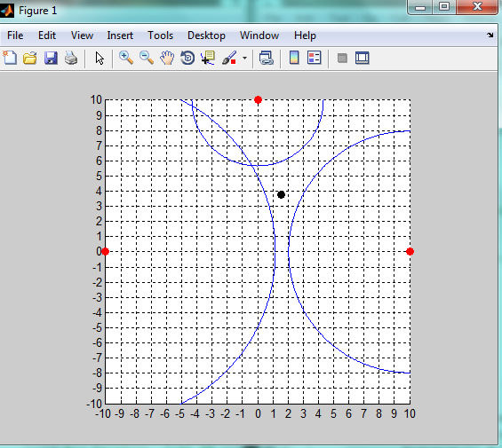
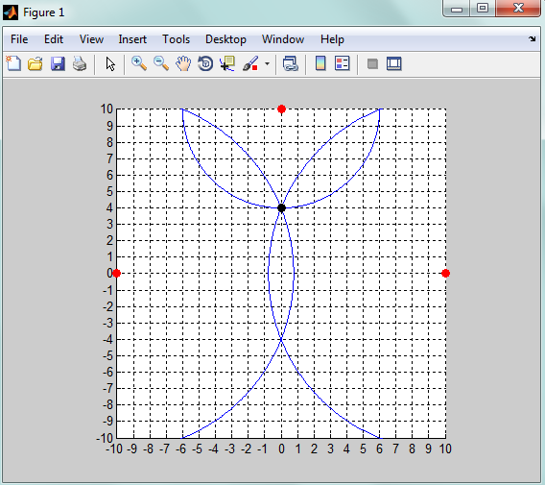
Parade Grounds
5 feet above ground (using stands)
Tag location: [0,4]
Results

Slide 32
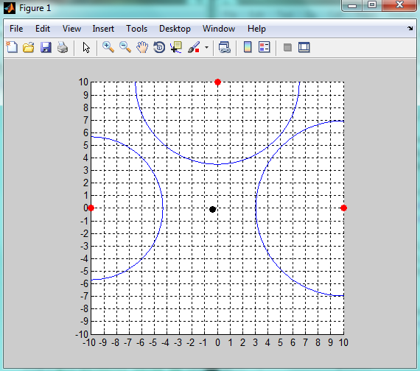
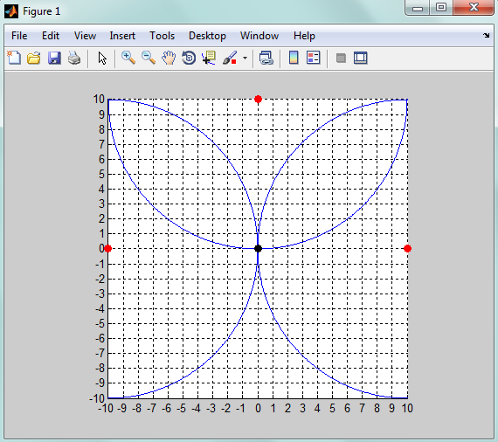
EE Parking Lot
5 feet above ground
Tag location: [0,0]
Results

Slide 33
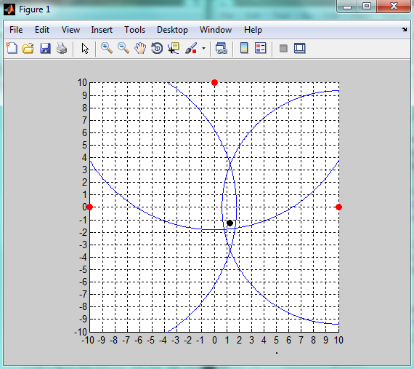
EE Parking Lot
5 feet above ground
Tag location [0, 0]
Results

Slide 34
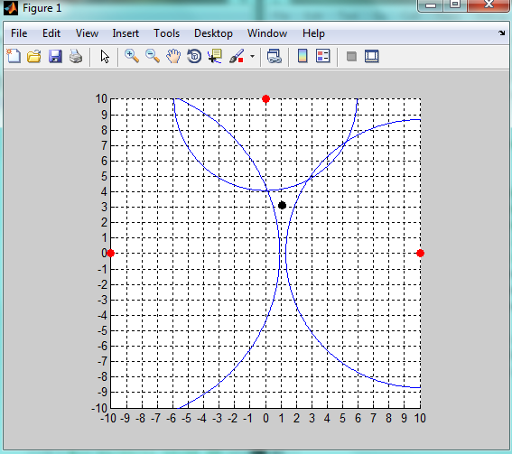
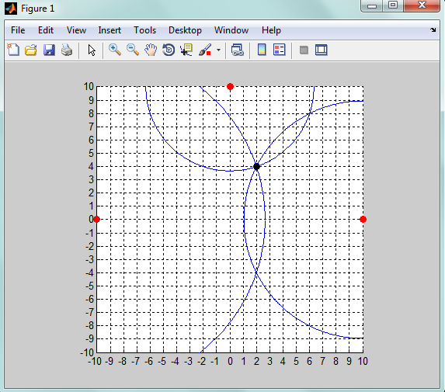
EE Parking Lot
5 feet above ground
Tag location: [2,4]
Results

Slide 35
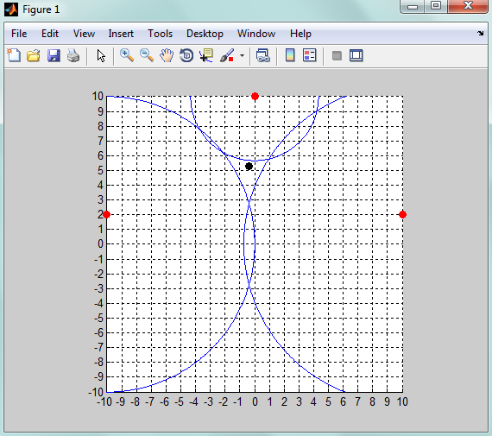
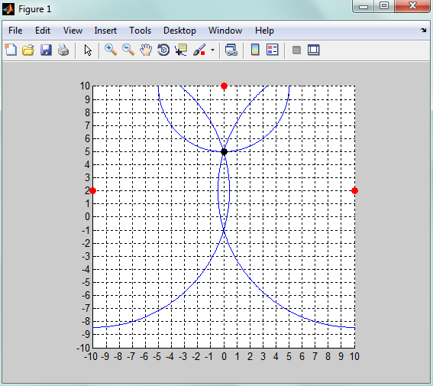
Gymnasium
5 feet above grounds
Tag location: [0, 5]
Results

Slide 36
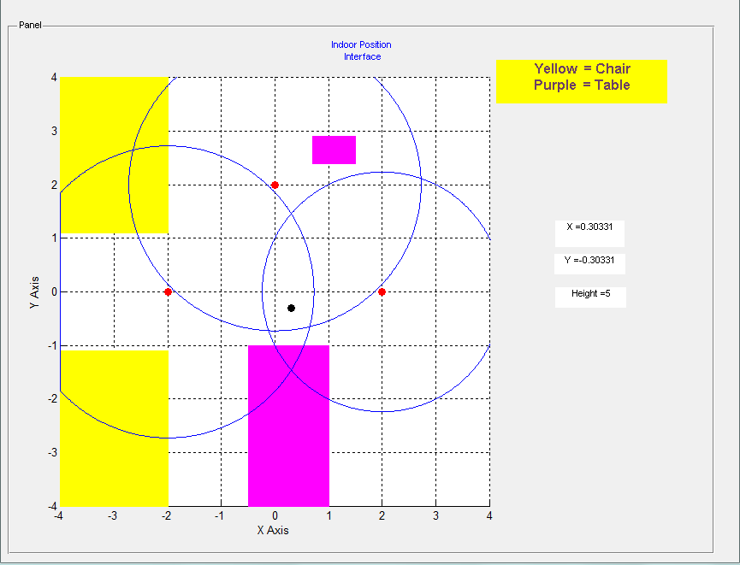
Implementation of Matlab GUI

Slide 37
Conclusion

Slide 38
Budget
Product | Individual Price | Number Ordered | Total Price
Lithium Ion Polymer Batteries | $16.95 | 2 | $33.90
Arduino Uno | $29.95 | 3 | $89.85
Arduino Fio | $25.00 | 1 | $25.00
Arduino Fio Cable | $20.00 | 1 | $20.00
Maxim 8212 Chip | $3.75 | 2 | $7.50
ID-12 Chip | $29.95 | 1 | $29.95
RFID Card | $1.95 | 2 | $3.90
DC Power Supplies | $1.90 | 6 | $11.40
Project Enclosure Box | $5.95 | 1 | $5.95
Digimesh XBee 2.4 GHz | $21.00 | 4 | $84.00
Xbee Shield | $24.95 | 4 | $99.80
802.15.4 Xbee 2.4 GHz(RPSMA) | $21.00 | 8 | $168.00
Titanis Antenna | $30.00 | 8 | $240.00
RPSMA to SMA Adapter | $6.99 | 8 | $55.92
Total: |  |  | $872.17

Slide 39
Performance Outcomes
Want to track multiple tags
Error of no more than 1 meter
User friendly
Mobile
Tag life of at least 1 year
Low cost
Real time tracking

Slide 40
Problems
Titanis antennas were too sensitive
Metal interference
Humidity and temperature
Moved outdoors
Radiation patterns were not uniform
Change XBee modules

Slide 41
Future Designs
Implement a wake-up circuit
Auto-tune for environmental effects
Better antennas for situation
3D trilateration

Slide 42
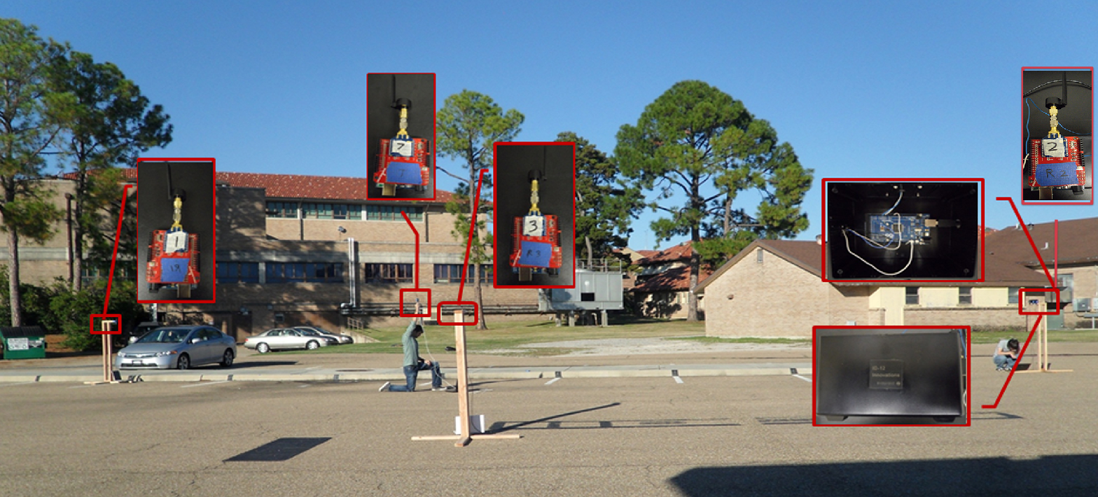
System Demonstration

Slide 43
Questions?
Acknowledgements
Mr. Scalzo, Dr. Kemin Zhou, Cameron Group, and Electrical and Computer Engineering Department

